Slide 1

DESIGN AND IMPLEMENT A RING AND JOHNSON COUNTER WITH CONTROL LOGIC”
END SEMESTER ASSESSMENT (ESA)
B.TECH. (CSE) III SEMESTER
DIGITAL DESIGN & COMPUTER ORGANIZATION LABORATORY
UE18CS206
Project Number:7
Project Batch Number: 4
Achyut Jagini PES2UG19CS013
Adithya M PES2UG19CS015
Aditya Mahesh Hegde PES2UG19CS01
Achyuta Bhimsen Mudhol PES2UG19CS014

Slide 2
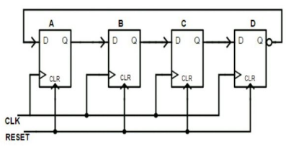
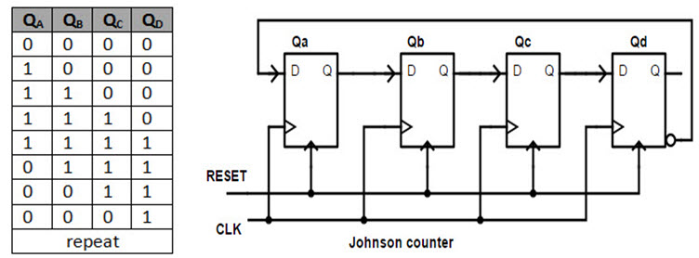
CIRCUIT DIAGRAM
aaasx
Ring counter johnson counter

Slide 3
VERILOG CODE USED ring.v
module ring_counter(
Clock,
Reset,
Count_out
);
//what are the input ports and their sizes.
input Clock;
input Reset;
//what are the output ports and their sizes.
output [3:0] Count_out;

Slide 4
//Internal variables
reg [3:0] Count_temp;
//Whenever the Clock changes from 0 to 1(positive edge) or
//a change in Reset, execute the always block.
always @(posedge(Clock),Reset)
begin
if(Reset == 1'b1) begin//when Reset is high
Count_temp = 4'b0001; end//The Count value is reset to "0001".

Slide 5
elseif(Clock == 1'b1) begin//When the Clock is high
//Left shift the Count value.
Count_temp = {Count_temp[2:0],Count_temp[3]};
End
//The Count value is assigned to final output port.
assignCount_out = Count_temp;
endmodule
p = {Count_temp[2:0],Count_temp[3]}; end
end

Slide 6
VERILOG CODE USED johnson.v
module johnson_counter(
Clock,
Reset,
Count_out
);
//what are the input ports and their sizes.
input Clock;
input Reset;
//what are the output ports and their sizes.
output [3:0] Count_out;

Slide 7
//Internal variables
reg [3:0] Count_temp;
//Whenever the Clock changes from 0 to 1(positive edge) or
//a change in Reset, execute the always block.
always @(posedge(Clock) or Reset)
begin

Slide 8
if(Reset == 1'b1) begin//when Reset is high
Count_temp = 4'b0000;
end//The Count value is reset to "0000".
elseif(Clock == 1’b1)
begin//When the Clock is high
//Left shift the Count value and at the same time
//negate the least significant bit.
Count_temp = {Count_temp[2:0],~Count_temp[3]}; end
end
//The Count value is assigned to final output port.
assignCount_out = Count_temp;
endmodule

Slide 9
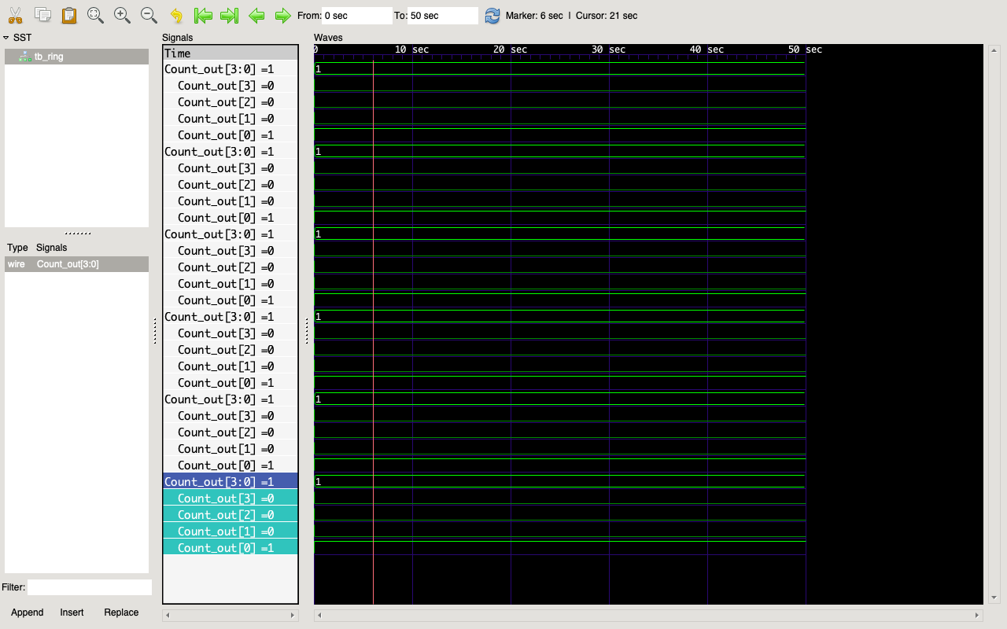
SCREENSHOTS:ring.v

Slide 10
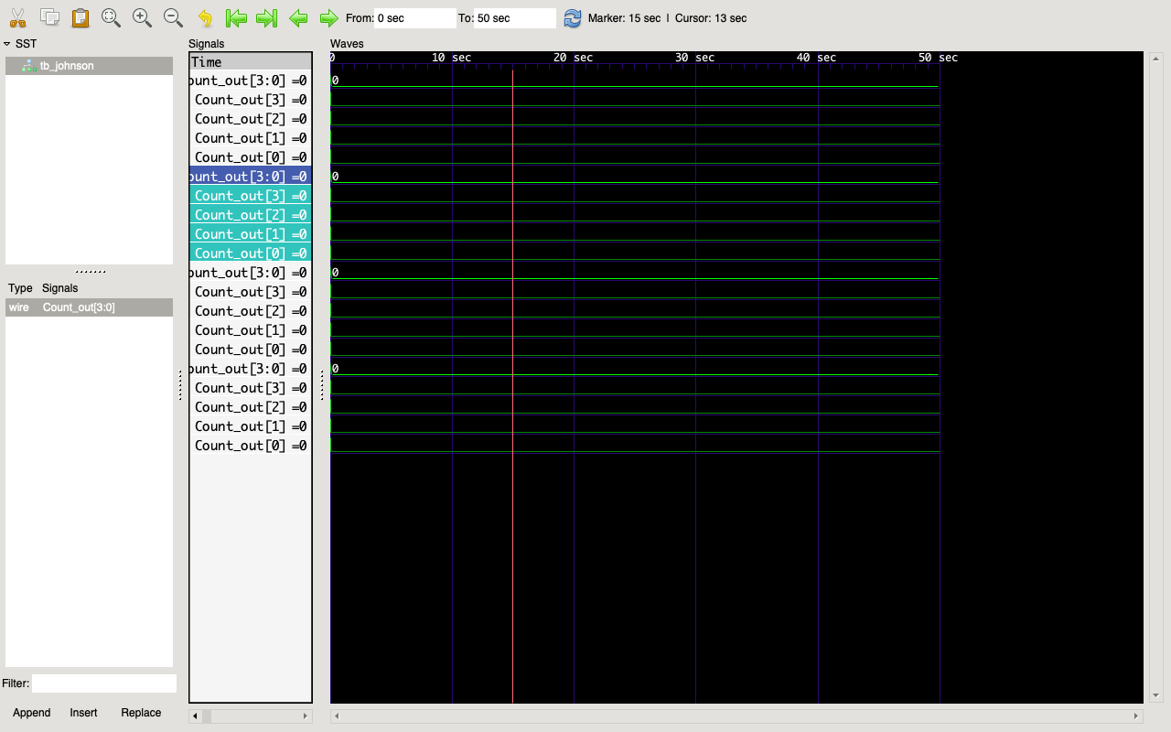
johnson.v

